Slide 1
COFFEE SHOP SALES PERFOMANCE ANALYSIS
GLADYS CHEROTICH
ID/C8/700127
Group D

Slide 2
Problem statement
Analyze transaction patterns to identify revenue drivers, popular coffee product ,dominant payment methods and busy hours to support pricing ,staffing ,inventory and customer service decisions.

Slide 3
Objective
Analyze overall coffee shop sales performance.
Identify the coffee products that generate the highest sales.
Analyze customer purchasing patterns across different coffee types.
Identify sales trends over time.

Slide 4
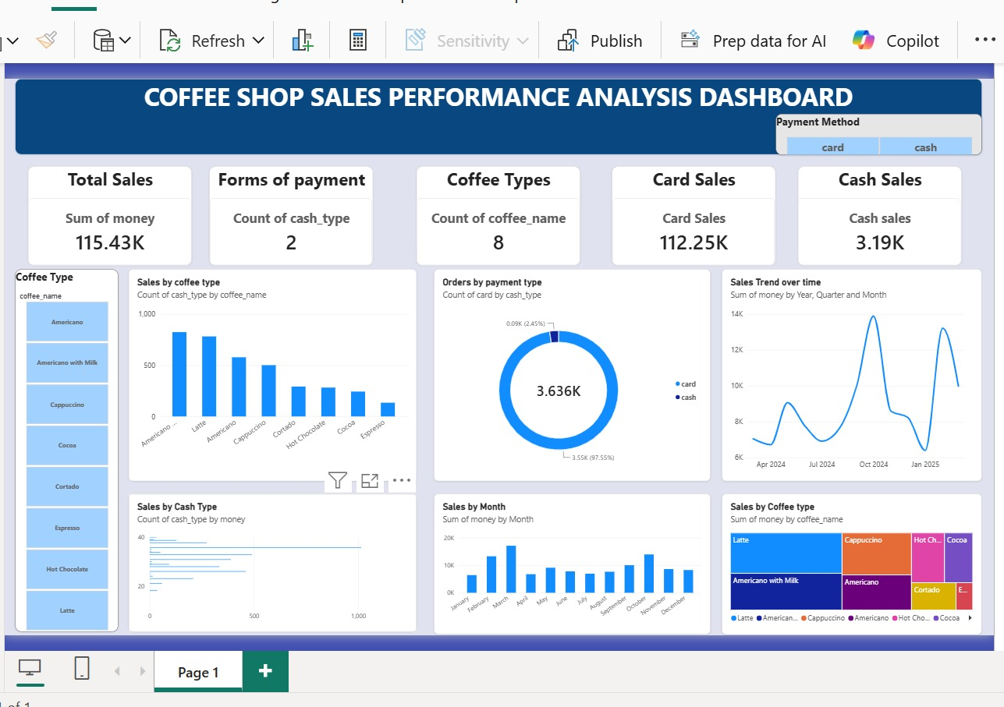
Insights
Sales by Coffee Type-Somecoffee types contribute to more sales than others showing that customers have clear product preferences.
Payment Methods: Customers use different payment methods.Card method accounting for a larger share of orders. This shows the importance of providing convenient payment options.
Sales Trend Over Time: Sales vary across different dates and periods. Identifying periods of higher and lower sales can help the business plan promotions, staffing and inventory.
Product Performance: The differences in sales between coffee types can help management identify best-selling products and products that may need promotional support.
Customer Purchasing Patterns: The sales data can be used to understand when and what customers are most likely to purchase supporting better inventory and marketing decisions.

Slide 5
Conclusion
Focus on best-selling coffee products
Ensure popular coffee types are available and consider promoting and upselling.
Promote low-performing products
Products with low sales should be included in promotions, discounts or combo deals to increase customer interest.
Maintain multiple payment options
Since customers use different payment methods the coffee shop should continue supporting convenient payment options to avoid losing sales.
Encourage repeat purchases
The coffee shop could introduce loyalty programs, discounts or personalized offers to encourage customers to return.

